Slide 1
Microsoft Azure AI Fundamentals: Computer Vision
Notes:
This content is meant to be taught as a companion to: Microsoft Azure AI Fundamentals: Computer Vision - Training | Microsoft Learn

Slide 2
Agenda
Computer vision concepts
Computer vision capabilities in Azure
Notes:
Time estimates:
- Computer Vision concepts: 20 minutes
- Computer vision capabilities in Azure: 20 minutes
- The lab exercise should take an additional 20 minutes

Slide 3
Learning Objectives
After completing this module, you will be able to:
1
Understand the capabilities of Azure AI Vision.
2
Identify the different services included in Azure AI Vision.
3
Describe the Face detection service.

Slide 4
Computer Vision Concepts

Slide 5
Images and image processing
An image is an array of pixel values
Filters are applied to change images
0 | 0 | 0 | 0 | 0 | 0 | 0
0 | 0 | 0 | 0 | 0 | 0 | 0
0 | 0 | 255 | 255 | 255 | 0 | 0
0 | 0 | 255 | 255 | 255 | 0 | 0
0 | 0 | 255 | 255 | 255 | 0 | 0
0 | 0 | 0 | 0 | 0 | 0 | 0
0 | 0 | 0 | 0 | 0 | 0 | 0
0 | 0 | 0 | 0 | 0 | 0 | 0
0 | 0 | 0 | 0 | 0 | 0 | 0
0 | 0 | 255 | 255 | 255 | 0 | 0
0 | 0 | 255 | 0 | 255 | 0 | 0
0 | 0 | 255 | 255 | 255 | 0 | 0
0 | 0 | 0 | 0 | 0 | 0 | 0
0 | 0 | 0 | 0 | 0 | 0 | 0
-1 | -1 | -1
-1 | 8 | -1
-1 | -1 | -1
Notes:
This is an animated slide. Practice the animation to make the following points.
A grayscale image consists of an array of pixel values between 0 (black) and 255 (white) (a color picture consists of three arrays called channels, each containing pixel values for red, green, and blue hues)
Most image processing involves the application of filters, which consist of kernels that define an array of weight values.
The filter kernel is convolved (passed across and down) over the image, calculating values for a new array by using a weighted sum of the original pixel values multiplied by the corresponding kernel weights.
The new array represents the filtered image, usually with some kind of visual effect. In this case, a filter names a Laplace filter has been used to highlight the edges of shapes in the original image.

Slide 6
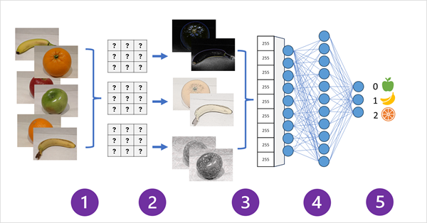
Convolutional Neural Networks
Labeled mages are used to train the model
Filter layers extract feature maps from each image
The feature maps are flattened
The feature values are fed into a fully connected neural network
The output layer produces a probability value for each possible class label
During training, the filter kernels start with random weights. These weights are iteratively adjusted to improve the accuracy of the predictions based on the known labels.
The trained model uses learned weights to extract features from new images and predict their class.
Notes:
One of the most common machine learning model architectures for computer vision is a convolutional neural network (CNN). CNNs use filters to extract numeric feature maps from images, and then feed the feature values into a deep learning model to generate a label prediction. For example, in an image classification scenario, the label represents the main subject of the image (in other words, what is this an image of?). You might train a CNN model with images of different kinds of fruit (such as apple, banana, and orange) so that the label that is predicted is the type of fruit in a given image.
During the training process for a CNN, filter kernels are initially defined using randomly generated weight values. Then, as the training process progresses, the models predictions are evaluated against known label values, and the filter weights are adjusted to improve accuracy. Eventually, the trained fruit image classification model uses the filter weights that best extract features that help identify different kinds of fruit.
The following diagram illustrates how a CNN for an image classification model works:
Images with known labels (for example, 0: apple, 1: banana, or 2: orange) are fed into the network to train the model.
One or more layers of filters is used to extract features from each image as it is fed through the network. The filter kernels start with randomly assigned weights and generate arrays of numeric values called feature maps.
The feature maps are flattened into a single dimensional array of feature values.
The feature values are fed into a fully connected neural network.
The output layer of the neural network uses a softmax or similar function to produce a result that contains a probability value for each possible class, for example [0.2, 0.5, 0.3].

Slide 7
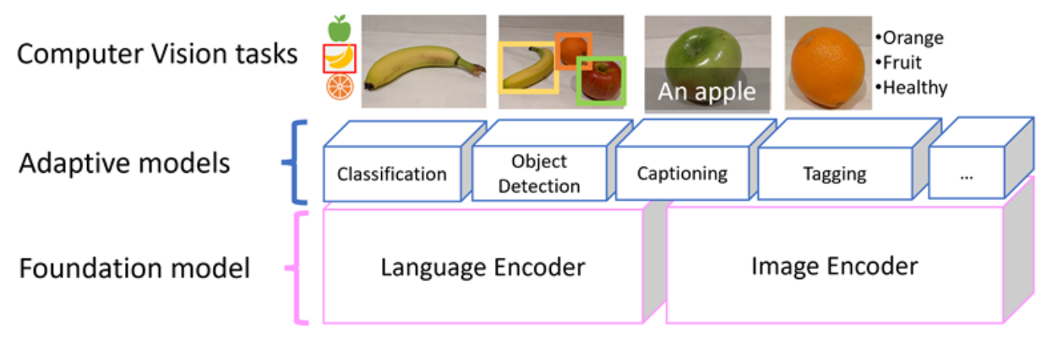
Multi-modal models
A newer approach to modeling involves combining language and vision models that encode image and text data
The model encapsulates semantic relationships between features extracted from the images and text extracted from related captions.
A multi-modal model can be used as a foundation model for more specialized adaptive models.
Notes:
The Microsoft Florence model, which is used for Image Analysis 4.0 capabilities in Azure AI Vision, is a multi-modal model. Trained with huge volumes of captioned images from the Internet, it includes both a language encoder and an image encoder. Florence is an example of a foundation model. In other words, a pre-trained general model on which you can build multiple adaptive models for specialist tasks. For example, you can use Florence as a foundation model for adaptive models that perform:
Image classification: Identifying to which category an image belongs.
Object detection: Locating individual objects within an image.
Captioning: Generating appropriate descriptions of images.
Tagging: Compiling a list of relevant text tags for an image.

Slide 8


Computer vision services in Azure
Vision | Face
Image Analysis: Image tagging, captions, model customization, and more. Optical Character Recognition (OCR) Spatial analysis | Face detection Face recognition
Notes:
We’ll cover some of the key capabilities of these computer vision related services in the rest of this module.
For more details of the capabilities of these AI services, see the documentation at:
- https://learn.microsoft.com/azure/ai-services/computer-vision/
- https://learn.microsoft.com/azure/ai-services/computer-vision/overview-identity

Slide 9
Computer Vision Capabilities in Azure

Slide 10
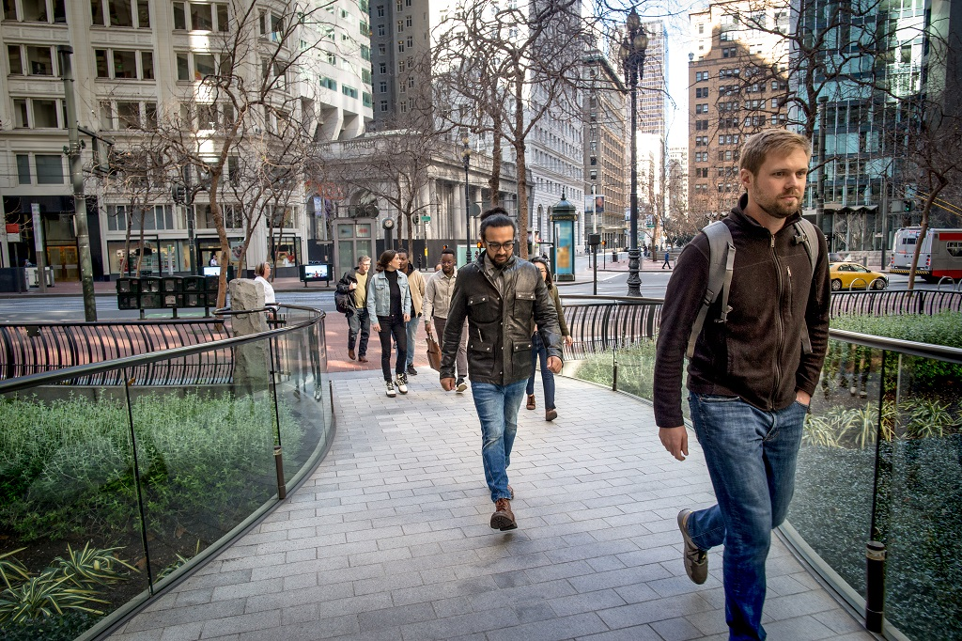
Image analysis 4.0 with the AI Vision Service
Capabilities include:
Model customization
Read text from images
Detect people in images
Generate image captions
Detect objects
Tag visual features
Smart crop
person
person
male (34)
jeans
footwear
Caption: A group of people walking on a sidewalk
Tags: Building, jeans, street, outdoor, jacket, city, person
Notes:
The Azure AI Vision Image Analysis service can extract a wide variety of visual features from your images. For example, it can determine whether an image contains adult content, find specific brands or objects, or find human faces.
You can use the Azure AI Vision Studio (portal.vision.cognitive.azure.com) to explore and test these capabilities.
Instructors: we recommend you open up Azure AI Vision Studio at this time. You can point out start options on the main page. After the next slide, you will demo the face service in the studio. Students will complete an image analysis lab in the studio.

Slide 11
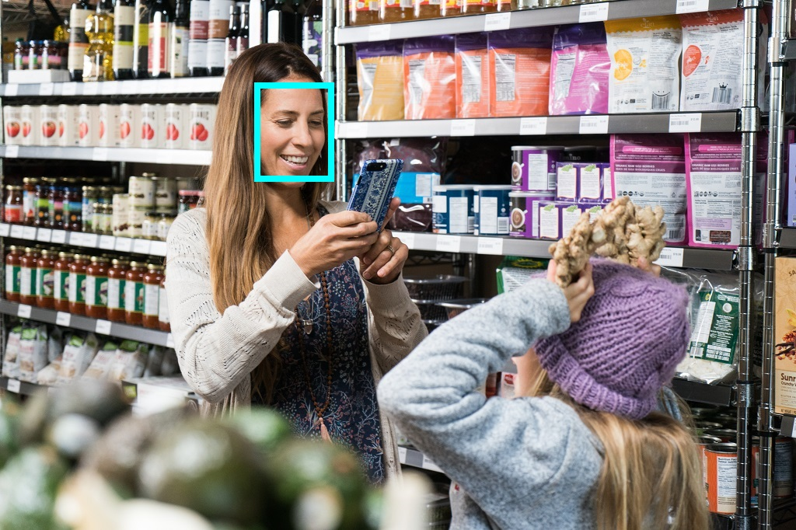
Detecting faces with the Face Service
Anyone can use the Face service to detect:
Blur
Exposure
Glasses
Head pose
Noise
Occlusion
Only Managed Microsoft customers can access facial recognition capabilities:
Similarity matching
Identity verification
*To support Microsoft’s Responsible AI Principles, Facial Recognition is under a Limited Access policy.
Notes:
While the AI Vision service provides some basic face detection and analysis features, the Face service offers additional capabilities. All users can use the Face service to detect:
- Blur: how blurred the face is (which can be an indication of how likely the face is to be the main focus of the image)
- Exposure: aspects such as underexposed or over exposed and applies to the face in the image and not the overall image exposure
- Glasses: if the person is wearing glasses
- Head pose: the face's orientation in a 3D space
- Noise: refers to visual noise in the image. If you have taken a photo with a high ISO setting for darker settings, you would notice this noise in the image. The image looks grainy or full of tiny dots that make the image less clear
- Occlusion: determines if there may be objects blocking the face in the image
Responsible AI use
To support Microsoft's [Responsible AI Standard](https://blogs.microsoft.com/on-the-issues/2022/06/21/microsofts-framework-for-building-ai-systems-responsibly/), a new [Limited Access policy](https://aka.ms/AAh91ff) has been implemented for the Face service and Computer Vision service.
Anyone can use the Face service to:
* Detect the location of faces in an image
* Determine if a face is wearing glasses
* Determine if there's occlusion, blur, noise, or over/under exposure for any of the faces
* Return the head pose coordinates for each face in an image
The Limited Access policy requires customers to [submit an intake form](https://aka.ms/facerecognition) to access additional Face service capabilities including:
* The ability to compare faces for similarity
* The ability to identify named individuals in an image

Slide 12

Demo: Detect faces in Vision Studio
Follow along on the exercise page at: https://aka.ms/ai900-face
In this demo, you will take a look at the face detection capabilities of the Azure AI Face service.
Notes:
Instructors: we recommend you complete the exercise ahead of time https://microsoftlearning.github.io/mslearn-ai-fundamentals/Instructions/Labs/04-face.html . During class, you can demonstrate the service.

Slide 13
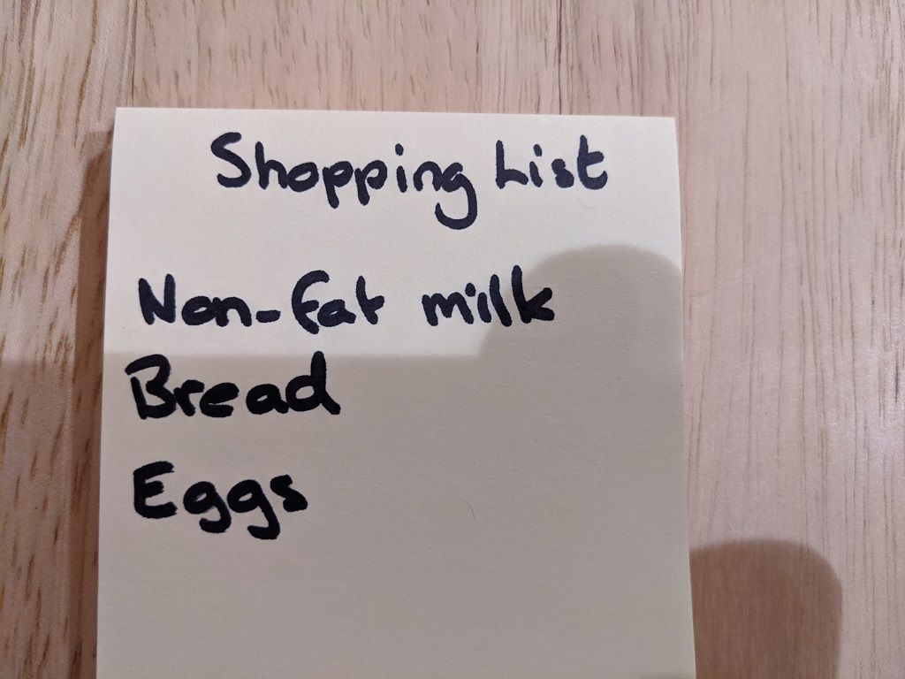
Reading text with Optical Character Recognition (OCR)
Detect the location of text:
Printed
Handwritten
Options for quick text extraction from images, or asynchronous analysis of larger scanned documents
Shopping List
Non-fat milk
Bread
Eggs
Notes:
We've already discussed the Computer Vision service and its use in image analysis. It also provides OCR capabilities to detect and extract text from images.
The service provides the Read application programming interface (API) that software developers can use to extract both printed and handwritten text from images, from immediate reading of small amounts of text in images to asynchronous text extraction from large documents.

Slide 14
Demo: Read text in Vision Studio
Follow along on the exercise page at: https://aka.ms/ai900-ocr
In this demo, you’ll see Azure AI Vision’s optical character recognition capabilities in action.
Notes:
Instructors: we recommend you complete the exercise ahead of time https://microsoftlearning.github.io/mslearn-ai-fundamentals/Instructions/Labs/05-ocr.html. During class, you can demonstrate the service.

Slide 15
Exercise: Analyze images in Vision Studio
Use the hosted environment and Azure credentials provided for this exercise.
In this exercise, you will use the Azure AI Vision service to analyze images.
The instructions are also available on Learn: https://aka.ms/ai900-image-analysis
Notes:
Point out that exercises are also available on Microsoft Learn for all of the other tasks demonstrated and discussed in this PowerPoint. https://microsoftlearning.github.io/mslearn-ai-fundamentals.

Slide 16
Knowledge check
1
You want to use the Face detection service to identify faces in images. What can be identified using the Face detection service?
Faces that cannot be seen because the person has turned their back.
Partially obscured faces.
Faces that are obscured by another object.
2
You want to use the AI Vision and AI Language service. You also want developers to require only one key and endpoint to access all your services. What kind of resource should you create in Azure?
Azure AI service
Language
Vision
3
Which services are part of Azure AI Vision?
Face detection and speech recognition
Optical Character Recognition and face detection
Document Intelligence and speech recognition
Notes:
Allow students a few minutes to think about the questions, then reveal the correct answers.

Slide 17

Summary
Computer vision concepts
What is Azure AI Vision?
Applications of AI Vision
Azure AI services
Computer vision capabilities in Azure
Image Analysis with the AI Vision service
Detecting faces with the Face service
Reading text with optical character recognition

Slide 18

References
Read more about:
Fundamentals of Computer Vision
Fundamentals of Facial Recognition
Fundamentals of Optical Character Recognition
Through the content on Learn: Microsoft Azure AI Fundamentals: Computer Vision - Training | Microsoft Learn
Notes:
Encourage students to review the content on Learn for more information.

Slide 19
Closing slide

